Slide 1
Cutting Propagation
Plant Propagation

Slide 2
Stock Plants
What are stock plants?
They are mother plants that serve as a source for harvesting cuttings.

Slide 3
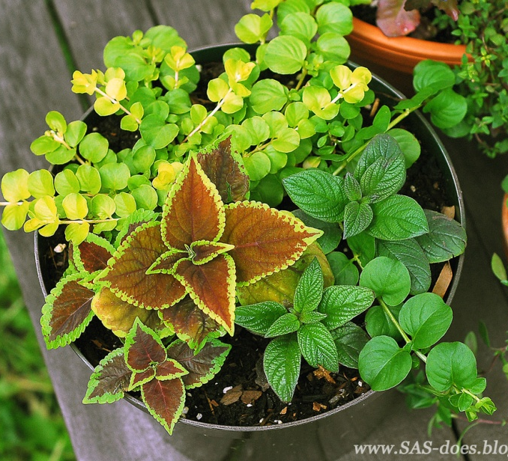
Stock Plants
container, shrub, tree
Care of Mother Plant:
Proper watering schedule
Long photoperiod, high light levels = more sugars = better rooting
Avoid heat stress
Light fertilizing – promotes healthy growth
Too much nitrogen - too soft growth prone to rotting
Not enough nitrogen-stiff cuttings –take too long to root
Pinching will encourage branching

Slide 4
Stock Plant Features
Healthy, vigorous
Free of disease
Compact, bushy growth
Newer cultivar
Good example of its type
Appropriate maturity level

Slide 5
Juvenility and Maturity
What is juvenility?
Refers to the chronological age of the tissue
Juvenile when seedlings
What is maturity?
Refers to the physiological age of the tissue
Mature stage when they flower and produce seeds

Slide 6
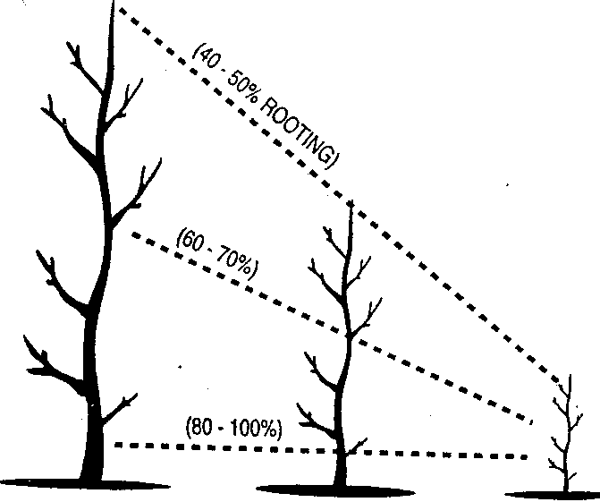
Juvenile vs. Mature Tissue
Mature Phase (can flower/fruit)
Juvenile Phase (cannot flower)
This is an important consideration for plants that are difficult to root. For example: rhododendron, yellow cedar, other tree species

Slide 7
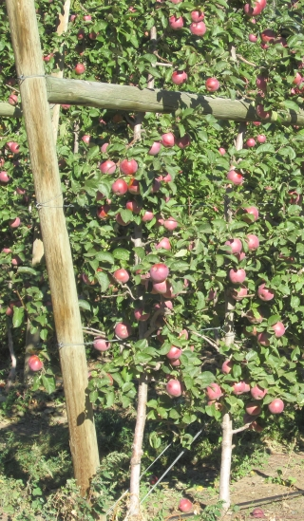
Why does the base of this apple tree flower and fruit?
Scion
(mature wood from bud)
Graft Union (budded)

Slide 8
Juvenile Wood
Found at the base of the plant
Produces more vigorous stems (easier to root)
For difficult to root plants species selecting juvenile wood will increase the chances of rooting success
Plants can be sheared close to the ground to increase the amount of juvenile wood

Slide 9
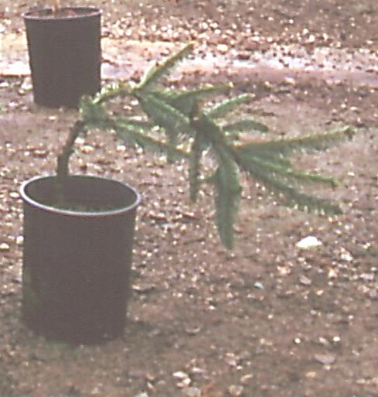
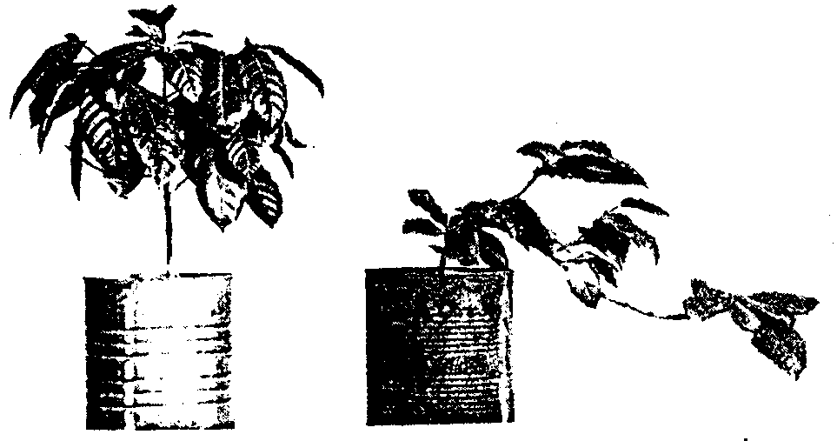
Growth Pattern of Cutting
Vertical cutting vs a cutting from a lateral shoot
The growth pattern for some shoots is retained after rooting. This is a positional or orientation effect. The plant on the right will need to be staked to correct the sideways orientation.

Slide 10
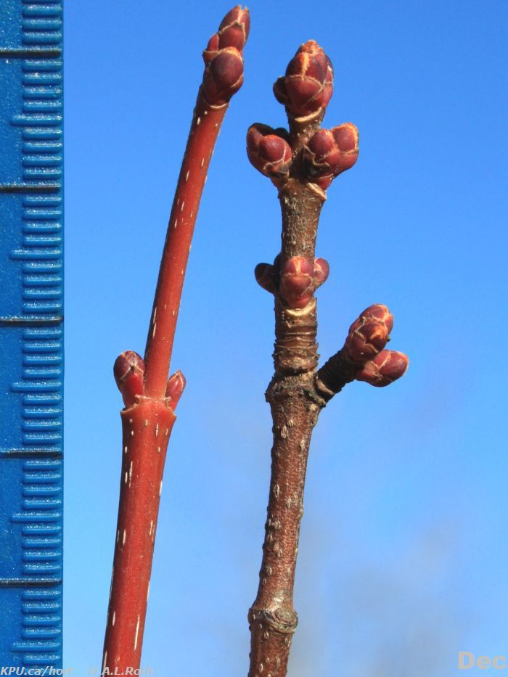
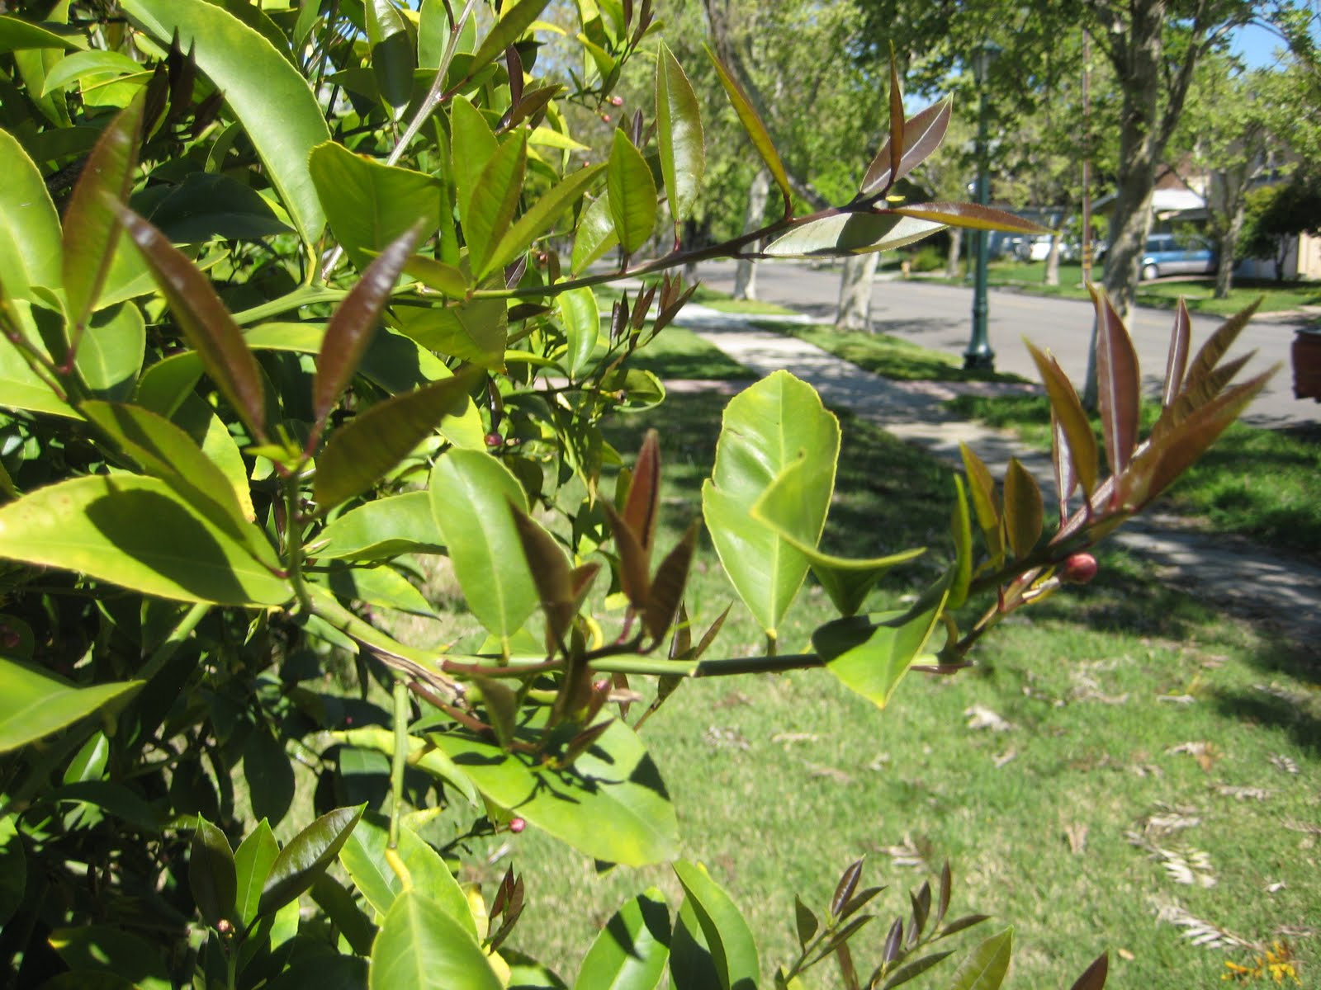
Ripeness of Wood
English Laurel new growth in the spring (softwood)
Red Maple ripe wood in winter (hardwood)

Slide 11
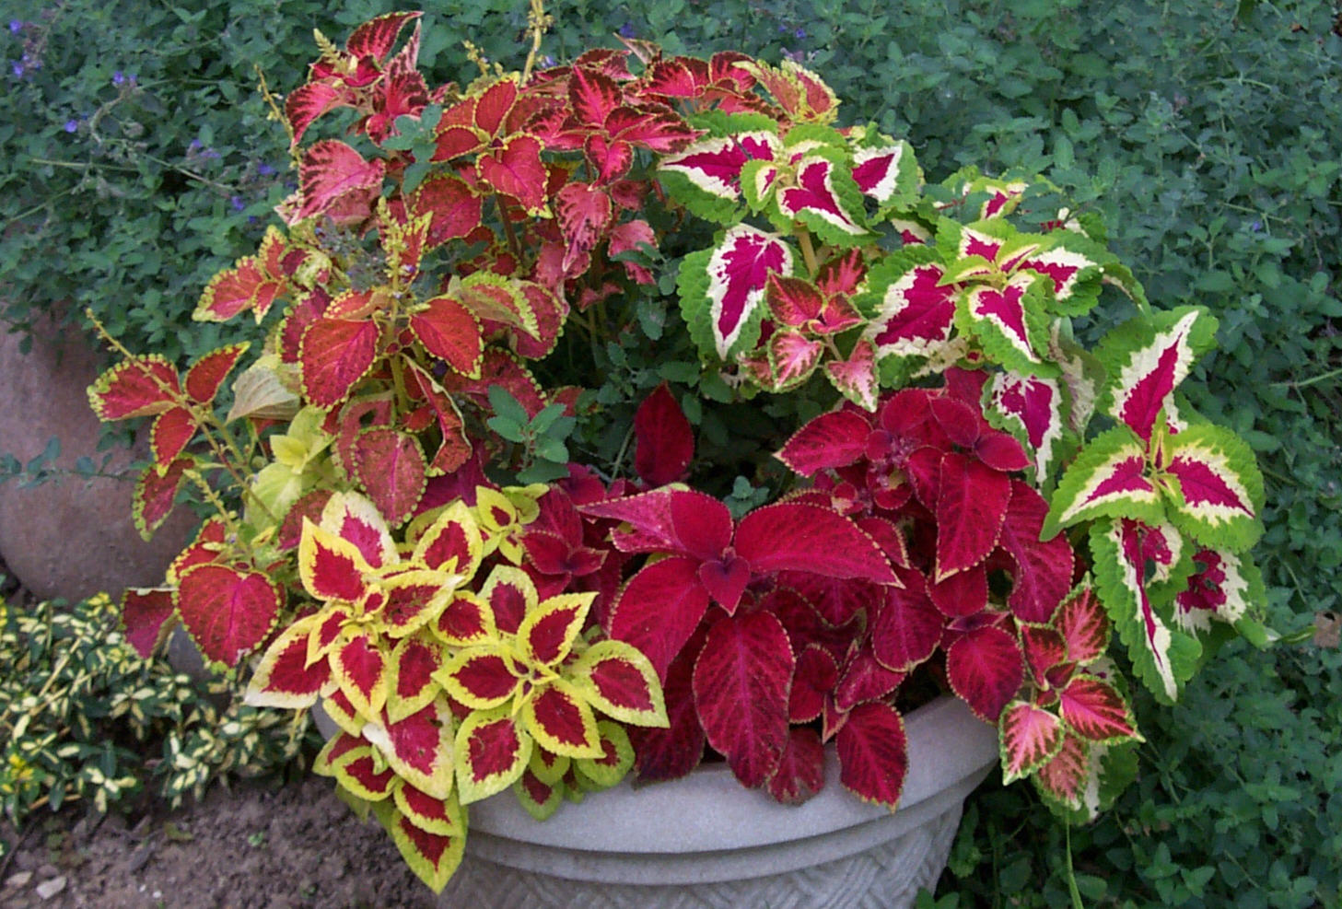
Ripeness vs Maturity
Ripeness is based on the stage of development of the wood
Maturity is based on the capacity of the tissue to reproduce
Herbaceous/softwood cuttings that are mature (can flower)
http://www.oisat.org/control_methods/plants_in_pest_control/coleus.html

Slide 12
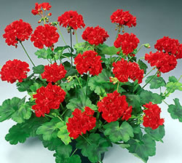
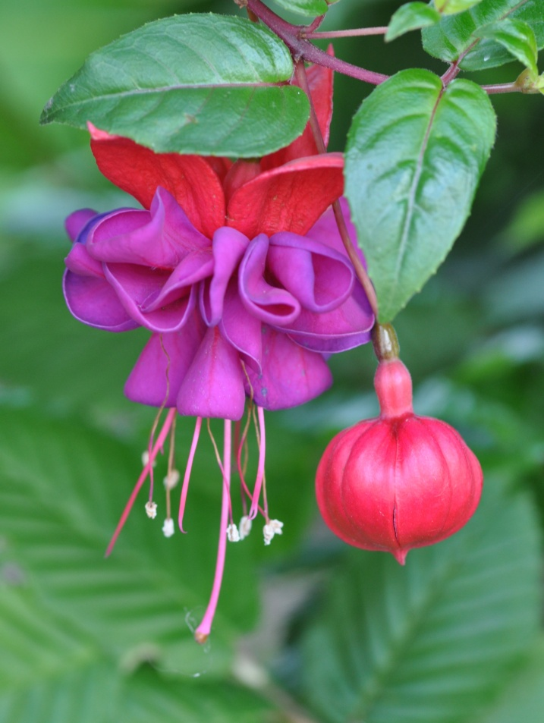
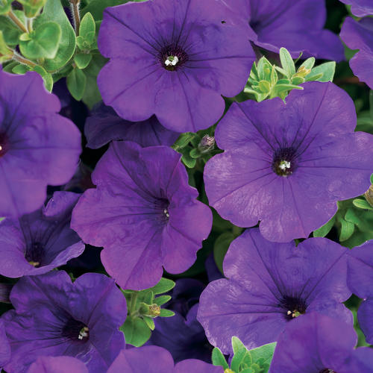
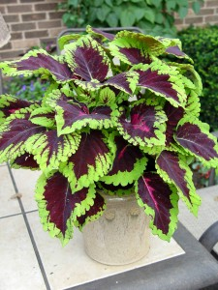
Herbaceous Stems
grandriveruel.ca
provenwinners.com
wikipedia.org
http://georgeweigel.net

Slide 13
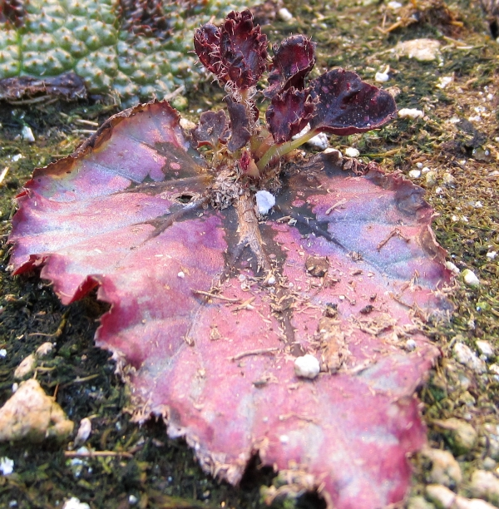
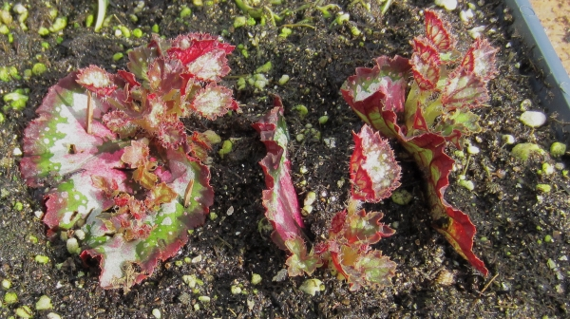
Leaf Cuttings
Rex Begonia produces adventitious shoots which root

Slide 14
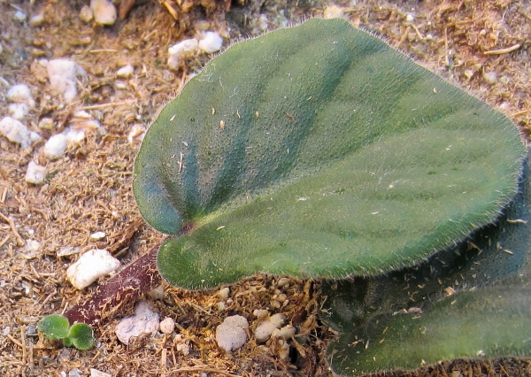
Violet Leaf Cuttings

Slide 15
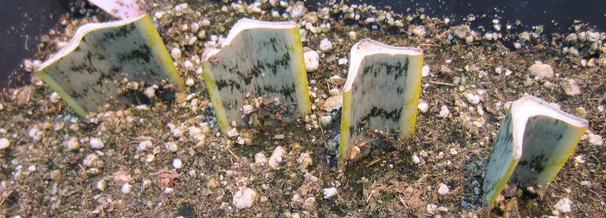
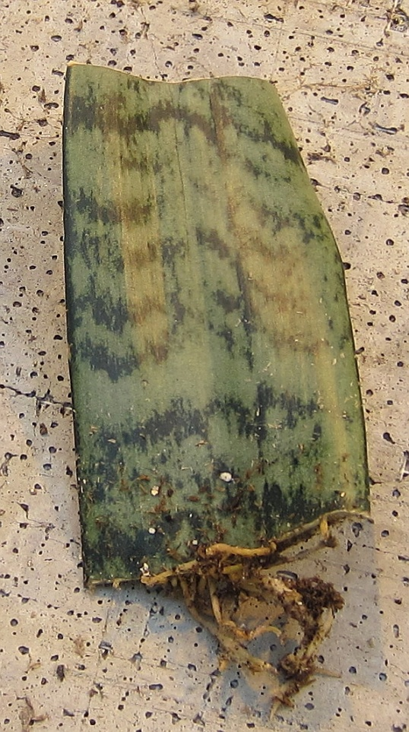
Leaf Cuttings
Snake Plant (Sansevieria)

Slide 16
Softwood Cuttings
Taken when the shoot is not ripe
Wood will “snap” when bent in half
Taken from June to mid July

Slide 17
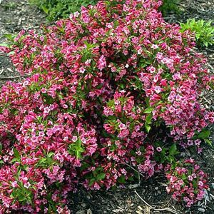
Softwood Stems
Weigela
Laurel
Plant Database Kwantlen Polytechnic University

Slide 18
Semi-ripe Hardwood
The wood of these cutting is firm but not hard like in dormancy
Taken any time after mid August to late September
Bottom heat of 18-21 ⁰C ensures quick rooting

Slide 19
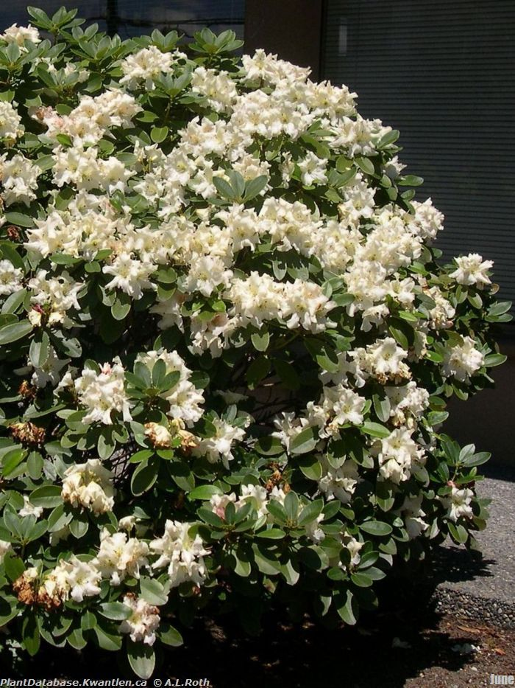
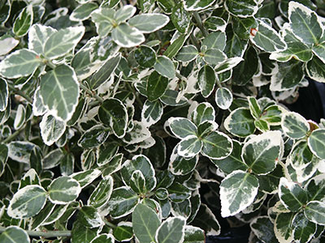
Semi-Hardwood
Emerald Gaiety Euonymus
Unique Rhododendron
Plant Database Kwantlen Polytechnic University

Slide 20
Hardwood Cuttings
Take from understock clones, deciduous shrubs, and small trees during wither
The branches are cut into 20 cm lengths then bundled
Minimum diameter should be pencil size
Bundles are dipped in rooting hormone and then placed in boxes of moist peat or sand
Cuttings are left in cold storage to callus

Slide 21
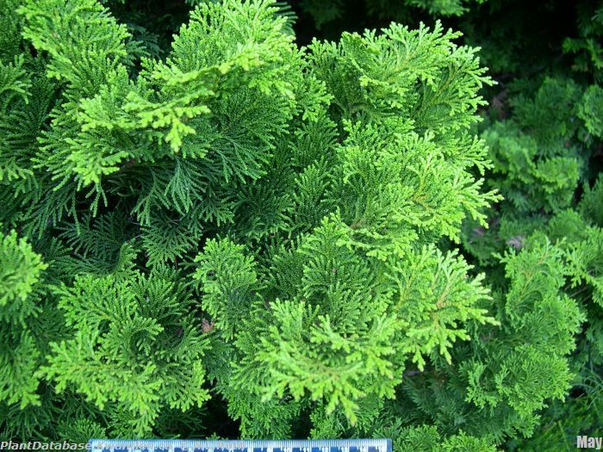
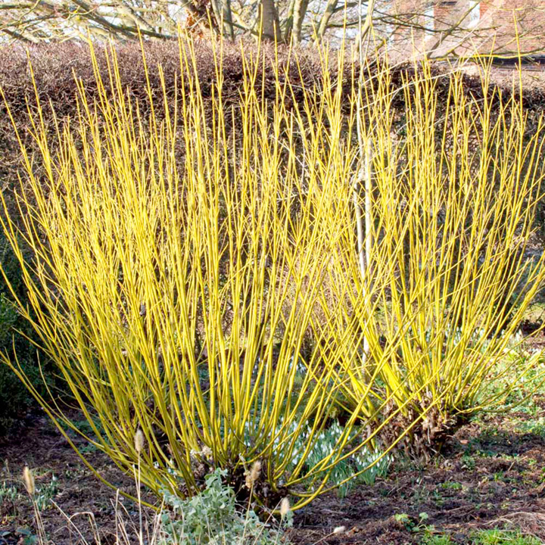
Hardwood
Chamaecyparis obtusa 'Gracilis'
Cornus stolonifera
Plant Database Kwantlen Polytechnic University

Slide 22
Wood Ripeness
Cutting Type | Time of Year
Herbaceous | Any time, new growth tips
Softwood | June to end of July
Semi-Hardwood | Mid-August to late September
Hardwood | End of November to February (dormant)

Slide 23
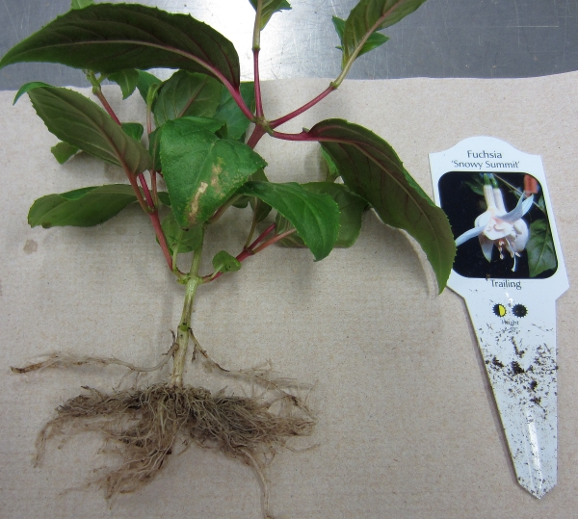
Rooting Hormones
Auxin initiates roots
Auxin does not add in root elongation
However, the more root initials, the more fibrous the root system
Easy to root plants have internal sources of auxin

Slide 24
Ease of Rooting
Easy to root – internal auxin supply ex: herbacious plants
Somewhat difficult to root – apply synthetic auxin to the cut end of the cutting
Very difficult or impossible to root – graft or layer the plant

Slide 25
Advantages of Applying Auxin
Increase number of successfully rooted cuttings
Decrease time to root
Increase the number and quality of roots
Improves the uniformity root the new root system

Slide 26
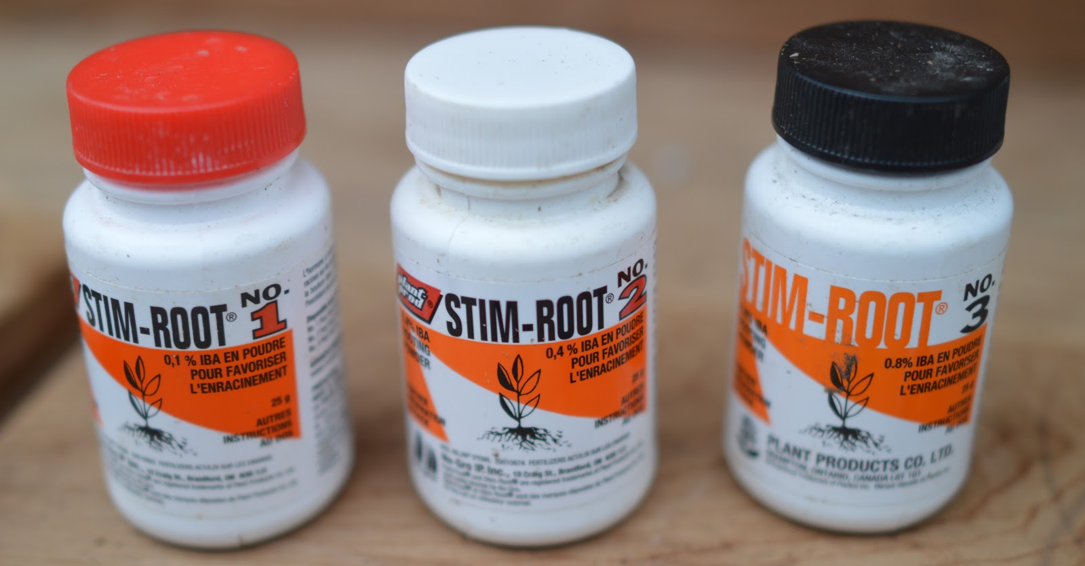
Rooting Powder
IBA plus talc
0.1% IBA (1,000 ppm)
0.4% IBA
(4,000 ppm)
0.8% IBA (8,000 ppm)

Slide 27
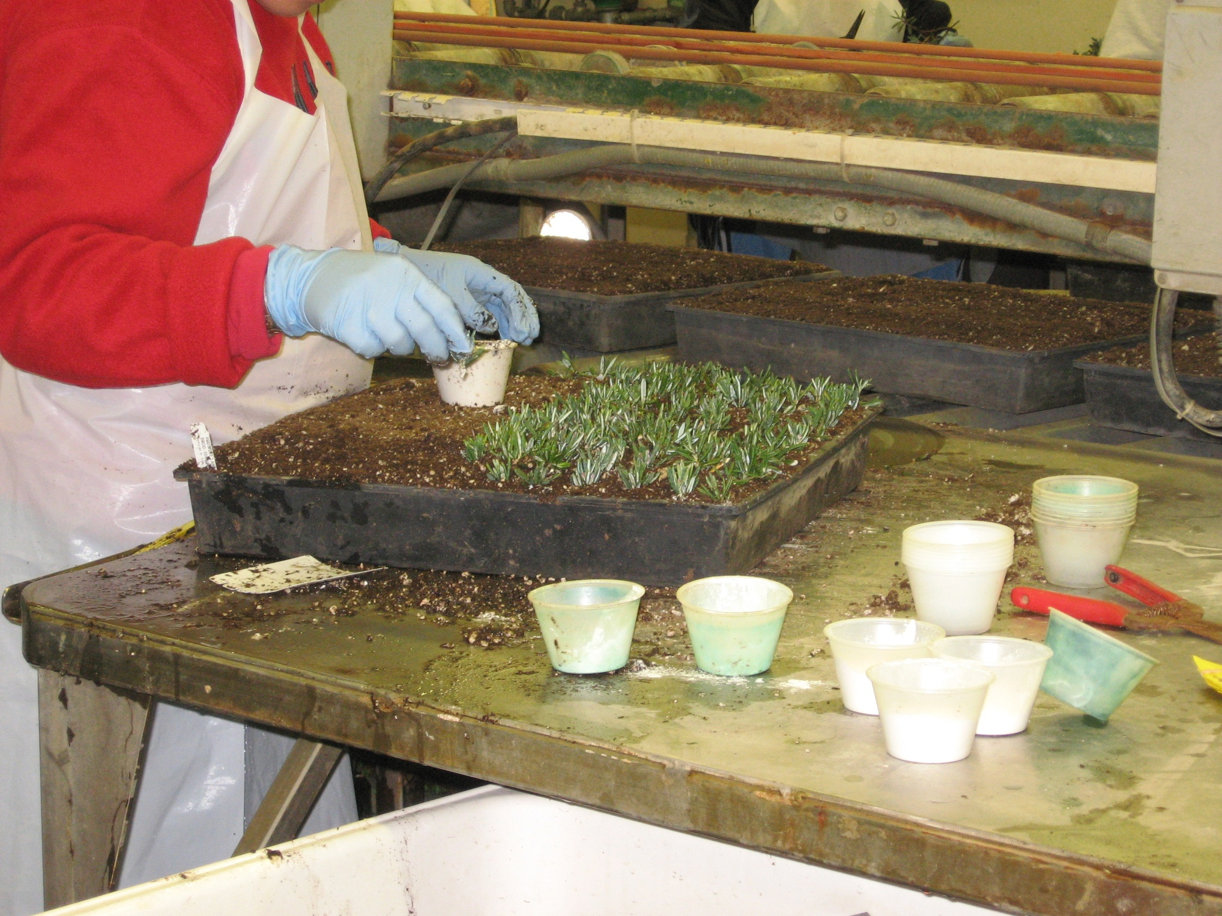

Slide 28
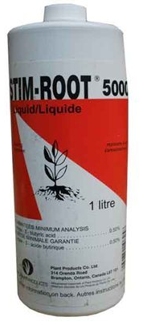
Liquid Rooting Hormone
Concentration of IBA to use relates to ripeness of wood and ease of rooting
Cutting ends are dipped into the liquid for 3 to 5 seconds before sticking into the rooting medium

Slide 29
Questions

